Slide 1

IBM Professional certificate:
Supervised Learning - Regression
Ibrahim Mohamed
July 2022

Slide 2
Main objective
This analysis' primary goal is to predict the Insurance Charges using a linear regression and other regularisation regressions.
This investigation tries train-test-split and cross-validation to get an idea of how these two strategies can influence model selection in different ways.
Show the correlation between the features and the target predicted value and the most feature with impact on it.

Slide 3
About the data
The data set used in this analysis is a dedicated to the cost of treatment of different patients.
The cost of patient treatment depends on many factors like the diagnoses, city, age, type of medical facility.
This data doesn’t include data about the patient diagnoses but we have general info about his health.
This data set has 1338 records and 7 variables.

Slide 4
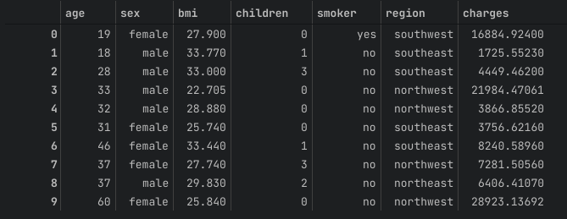
Data exploration
Features:
age: age of customer | patient
sex: male-female
bmi: body mass index
children: number of children
smoker: smoking or not smoking
region: residential area
charges: treatment charges

Slide 5
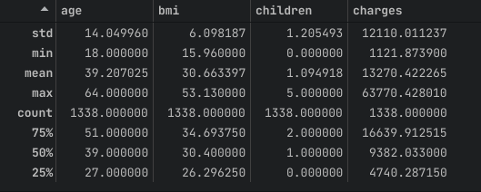
Data exploration
Description:
Mean
Std
age : 39
bmi : 30.6
children: 1
charges : 13270$
age : 14
bmi : 6
children: 1
charges : 12110$
Max
Min
age : 64
bmi : 53.13
children: 5
charges : 63770.43$
age : 18
bmi : 15.96
children: 0
charges : 1121.87$

Slide 6
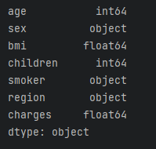
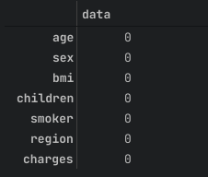
Data exploration
Data Types & Null Values
Our Data Types are the following
Our data doesn’t have any missing values

Slide 7
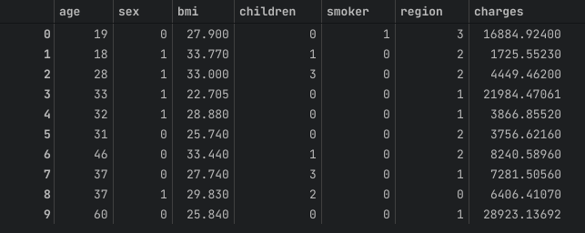
Exploratory data analysis
Converting categorical features into numerical features

Slide 8
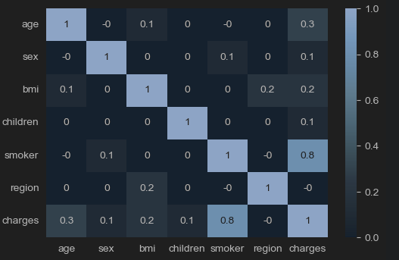
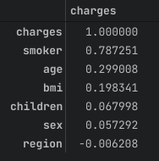
Exploratory data analysis
Correlation between features
From the heat map we notice that there is a strong correlation between the smoking and the chargers and a very weak correlation between the region and the charges

Slide 9
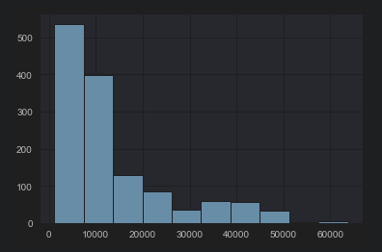
Exploratory data analysis
Data Normality
Implementing a model to a normally disturbed target value leads to better results, so we will make a test to our value to make sure it is normally distributed. These tests are visualizing the data and the p-value calculations
Visual
P-value calculations
statistic = 336.8851220567733
p-value = 7.019807901276e-74

Slide 10
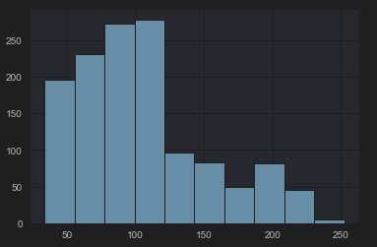
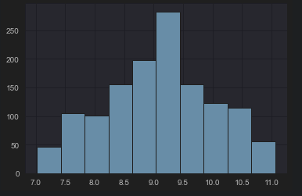
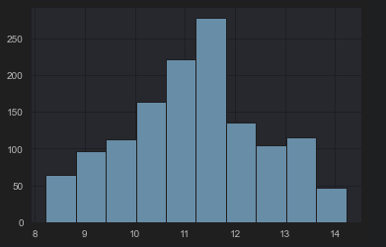
Exploratory data analysis
Data Normality
From the previous, we conclude that the target value is not normally distributed, so we have to apply a transformation
Square root transformation
Log Transformation
Box Cox Transformation

Slide 11
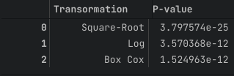
Exploratory data analysis
Data Normality
In order to keep things simple, we can use the log transformation as there isn't much of a difference between it and the Box Cox transformation, as indicated in the table on the right. To make our target distribution more normalized!

Slide 12
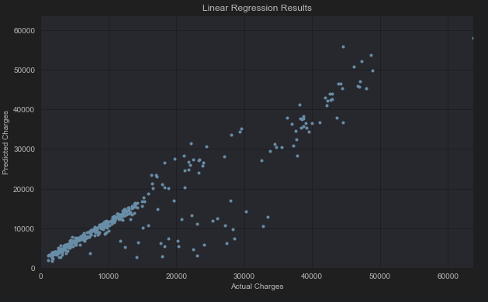
Machine learning analysis
Linear Regression Model
Model Features and Parameters:
Model = LinearRegression()
Polynomial Features degree = 2
Standard Scalar
RMS_score | R2_Score
4496.560110896 | 0.862102995

Slide 13
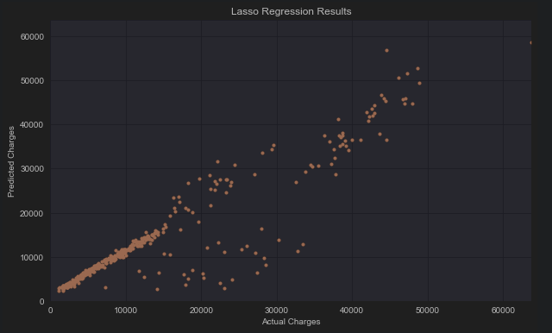
Machine learning analysis
Lasso Regression Model
Model Features and Parameters:
Model = Lasso()
Polynomial Features degree = 2
Standard Scalar
Alpha = 13.7454
max_iter = 10000
RMS_score | R2_Score
4496.577651935 | 0.862101919

Slide 14
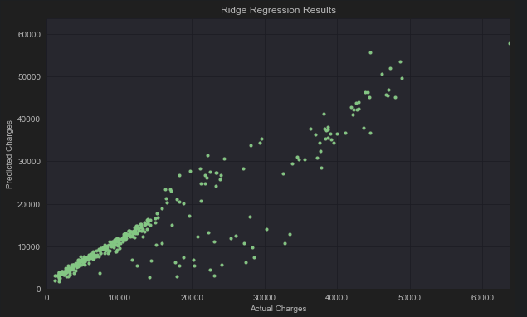
Machine learning analysis
Ridge Regression Model
Model Features and Parameters:
Model = Ridge()
Polynomial Features degree = 2
Standard Scalar
Alpha = 0.55974
max_iter = 10000
RMS_score | R2_Score
4494.682979659 | 0.862218104

Slide 15
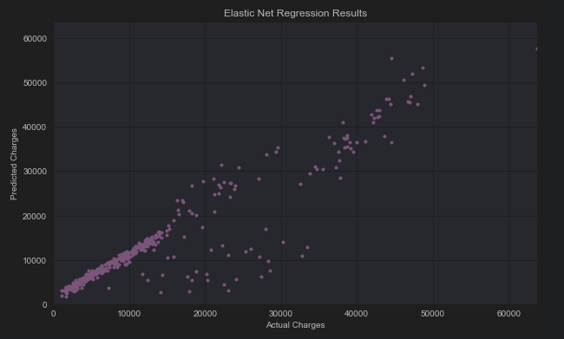
Machine learning analysis
ElasticNet Regression Model
Model Features and Parameters:
Model = ElasticNet()
Polynomial Features degree = 2
Standard Scalar
Alpha = 0.008111
L1 ratio = 0.9
max_iter = 10000
RMS_score | R2_Score
4494.417700642 | 0.862218104

Slide 16
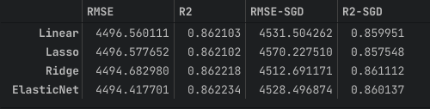
Machine learning analysis
Models Comparison
The used models have closely similar results and they are close to each other. It won’t be a problem to choose anyone to get the job done. But according to the highest result it would be the ElasticNet model.

Slide 17
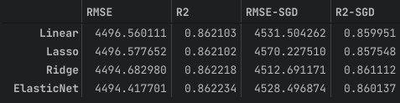
Machine learning analysis
Regularization
When a regularization is added to our models it conducted a worst results, so we will be using the models without regularization and the ElasticNet Model will be our selected one for this dataset.

Slide 18
Analysis Next Steps
Models Flaws and Strength and further suggestions
From a simplicity point of view, linear regression provided high prediction results and the simplest and fastest model from a parameter point of view, but other models Lasso, Ridge and ElasticNet gave higher results.
However, more results have been obtained since then. We used a complex and slow grid search technique to find the best parameters, but it took a long time. Therefore, there is a trade-off in the end. The performance of these models is high for large datasets, but the training process can be time consuming. If you decide to use a linear model, the accuracy is relatively sacrificed, but the training process will be much faster

